Slide 1



SHARE BOARD
A REAL TIME CHAT WEB APPLICATION
CREATED BY:
20IT071 NEEL MODI
20IT082 ARYAKUMAR PATEL
GUIDED BY
PROF. SANDIP PATEL

Slide 2
CONTENTS
INTRODUCTION
MODULES
FRONT END AND BACK END
DATA FLOW DIAGRAM
SCREEN SHOTS
CONCLUSION
REFERENCES

Slide 3
INTRODUCTION
ShareBoard uses Web-based apps, which permit communication that is usually addressed directly but is anonymous among users in a multi-user environment.
Shareboard is virtually any online communication that provides a real-time or live transmission of text messages from sender to receiver.
A variety of software programs are available to enable real-time chat between individuals using Internet services.
Shareboard can be any direct text-based one-to-one chat or one-to-many group chats by means of tools like instant messengers (IMs), talkers, Internet Relay Chat (IRC) and multi-user dungeons(MUDs).
ShareBoard having a additional functionality to create new room and join easily.

Slide 4
MODULEs
SIGN IN WITH GOOGLE PAGE
HOME PAGE
ROOM PAGE

Slide 5
FRONT END
HTML
CSS

Slide 6
BACK END
NODE.JS
EXPRESS.JS
SOCKET.IO
FIREBASE

Slide 7
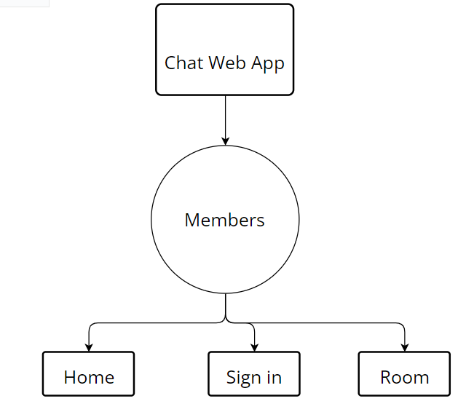
Data flow diagram

Slide 8
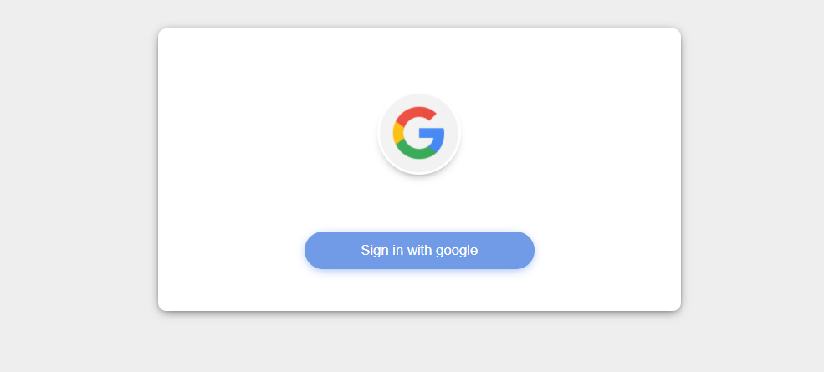
SIGN IN PAGE
This is a Sign In page of our project ‘ShareBoard’.
User can Sign in to enter into a home page.

Slide 9
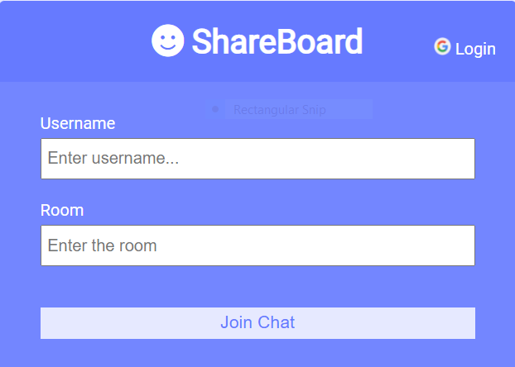
Home page
This is a Home Page where user has to enter a Username and Room name to start a conversation.

Slide 10
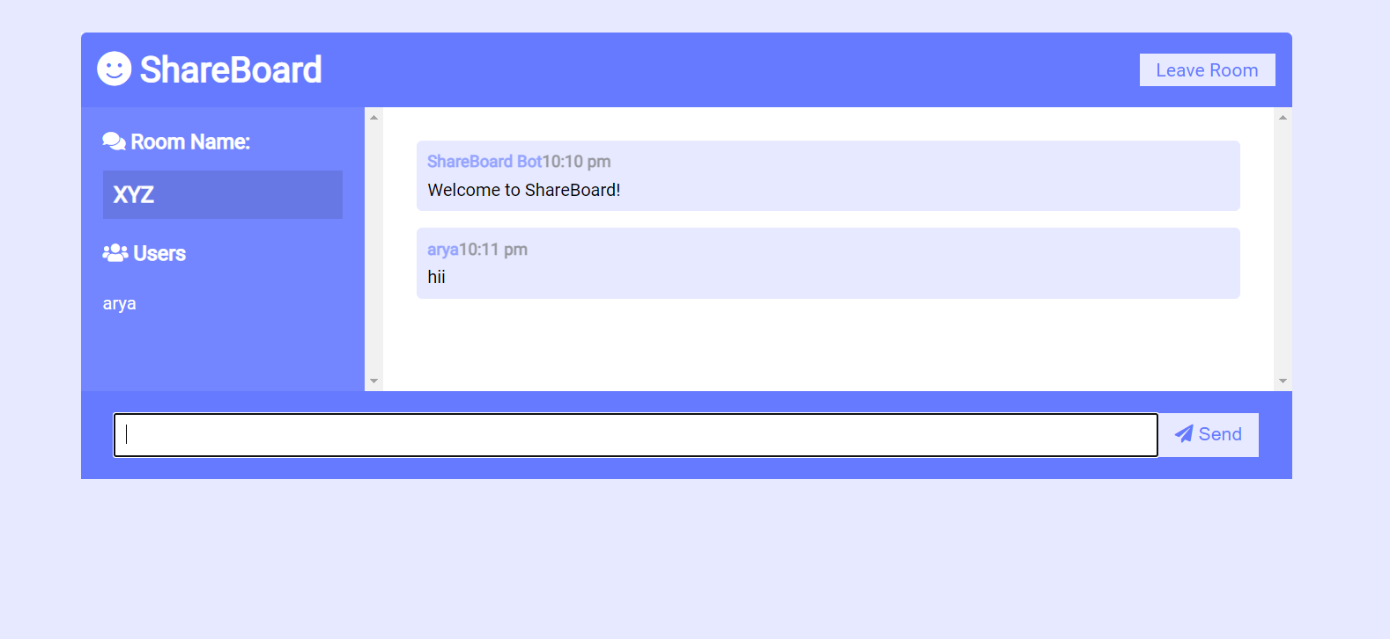
Room page
This is Room page where two or more user can conversation to each other.

Slide 11
Conclusion
We’ve seen that making “Real Time Chat Webapp” is quite interesting thing and new thing to make other than making a website about a product or any portfolio. As, I can say that socket.io made chat webapp easy to build and develop our own chat webapp. I can say that because of this project I got to learn a lot more than I expected.
At last I would like to say that making chat application using Node.js & Socket.io is best for mainly 2 thing, first is reducing time by just texting in some seconds and second one is you will learn a lot while making this app and till completing this application you have good hands on this technology.

Slide 12
REFERENCES
Al-Riyami, SS and K.G. Paterson, 2003. Uncertified public key cryptography. Methods for the Ninth World Theoretical Conference furthermore, Use of Cryptology and Information Security, November 30- Dec. 4, Springer Berlin Heidelberg, Taiwan, pages: 452-473. DOI: 10.1007/978-3-540-40061-5_29 Azab, A., P. Watters and R. Layton, 2012.
Matches the Skype Network Traffic Forensics. 3 Internet Criminal Procedures and Trusted Computer Workshop, October 29-30, IEEE Xplore Press, Ballarat, pages: 19-27. Segment: 10.1109/CTC.2012.14 Bardis, N.G. furthermore, K. Ntaikos, 2008.

